Slide 1
Planning for Peace of Mind:
A Workshop on Advance Care Planning
May 25, 2023
Elsie Castrorao, MSN, RN, ANP-NPC, AOCNP
Rutgers Cancer Institute of New Jersey
Deborah Leif, MSW, LCSW, OSW-C
Rose Slirzewski, LCSW
Rutgers Cancer Institute of New Jersey

Slide 2
What is Advance Care Planning (ACP)?
Anything you do that helps you, your family, friends and medical team know about the care you want to receive, including but not limited to:
  Getting information on the types of treatments available; your care options
  Deciding what types of treatment you would or would not want to receive
  Sharing your personal values with your loved ones; especially what quality of life means to you.
  Completing advance directives to put into writing what treatment options you would and/or would not want, should you be unable to speak for yourself
  Source: www.nhpco.org

Slide 3
Did You Know…
The 1990 Patient Self-Determination Act encourages everyone to decide ahead of time about the extent and types of medical care they want to accept and/or refuse in the event they are unable to make these decisions due to illness. It also requires healthcare providers to ask if you have an advance directive.
A survey, conducted by the Conversation Project, reported that more than 9 in 10 Americans think it is important to discuss their wishes for end-of-life care. However only 3 in 10 have actually had these discussions.
A review of 150 studies with nearly 800,000 participants showed 36.7% had an advance directive (29.35 were living wills). Proportions of patients with chronic illnesses (38.2 percent) and healthy adults (32.7 percent) who had completed advance directives were similar. *
Experts recommend hospitalists (dedicated in-patient physicians who work exclusively in hospitals) engage in ACP with all patients 65 years or older, instead of screening for those with serious illness.**
April 16 is recognized each year as National Health Care Decisions Day
* Source: Yadav, K. N., Gabler, N. B., Cooney, E. et al. Approximately One In Three US Adults Completes Any Type Of Advance Directive For End-Of-Life Care https://www.healthaffairs.org/journal/hlthaff
** Source: Mohan, D., Sacks, O.A., O’Malley, J. et al. A New Standard for Advance Care Planning (ACP) Conversations in the Hospital: Results from a Delphi Panel. J GEN INTERN MED 36, 69–76 (2021). https://doi.org/10.1007/s11606-020-06150-0

Slide 4
Did You Know…
You don’t need a lawyer to complete an advanced directive. It can be witnessed by two adults who are not your healthcare proxy.
Is your spouse your healthcare proxy? If you become divorced or legally separately, this will be revoked. If not legally separated, the proxy remains as is.
Haven’t decided on a healthcare proxy? The priority order of persons who would be asked to make decisions for you, if you could not speak on your own behalf are:
1. spouse, partner in a civil union couple, or domestic partner, if not legally separated
2. child, age 18 or older
3. parent
4. sibling, age 18 or older
5. close friend
Advance care planning is about what treatment and care you would and would not want .… these are equally important.

Slide 5
Did You Know…
Who you choose as your healthcare proxy is important. Your proxy needs to be able to act on your wishes. That may or may not be the person with whom you are closest.
If you choose someone other than the expected person (spouse, partner or sibling for example), make sure everyone is aware of your decision.
When you choose an unexpected person, it can be difficult to communicate. Just be honest, clear and keep it simple.

Slide 6
How Do I Begin The Conversations With My Family?
“I need your help with something.”
“I was thinking about what happened to _____ and it made me realize…”
“Even though I’m okay right now, I’m worried that…..and I want to be prepared.”
“I need to think about the future. Will you help me?”
“I just answered some questions about how I want the end of my life to be. I want you to see my answers. And I’m wondering what your answers would be.”
Sources: www.ihi.org and www.theconvesationproject.org

Slide 7
How Do I Prepare For My Advance Care Planning?
Things to think about:
  How do I get more information about my treatment options?
  What would I want people to know so that they could honor what I want and don’t want?
  Who would I want to share this with?
  How would I want to share this?
Next steps:
  Start small-write down three things you want your doctor, family and friends to know about how you would like the end of your life to be.
  Prepare questions for your doctor.
  Think about roadblocks, push back and potential disagreements between those closest to you.
  Source: www.nhpco.org

Slide 8
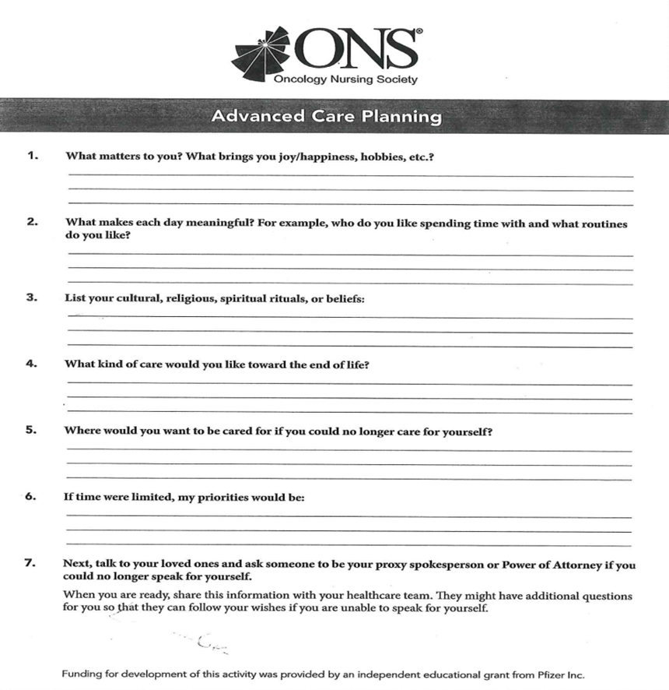

Slide 9
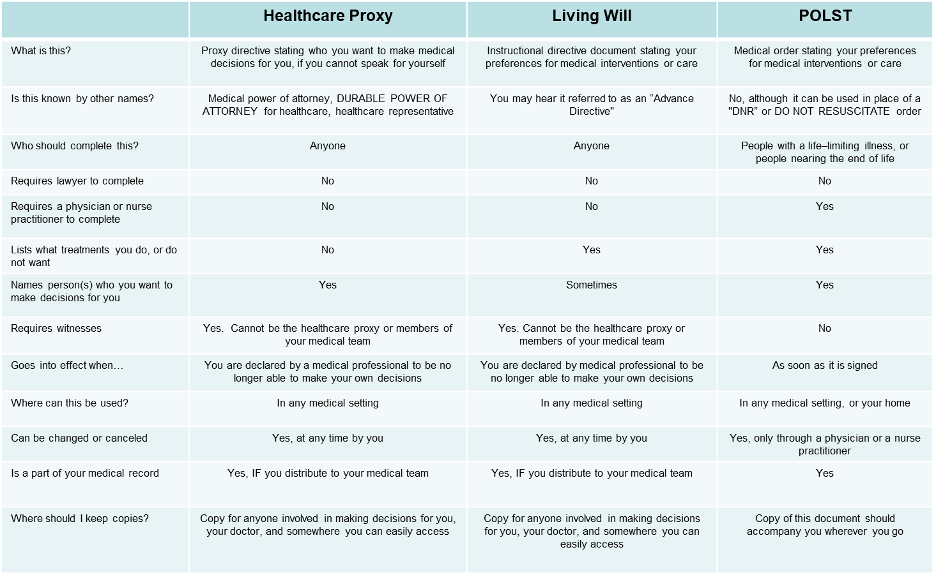

Comparison Chart: Advance Directives

Slide 10
New Jersey Advance Directives
Proxy Directive
(Durable Power of Attorney for Health Care)
Instructive Directive
(Living Will)
https://www.state.nj.us/health/advancedirective/documents/proxy_directive.pdf
On this form you choose who will make decisions for your medical care when you are not able to do so.
On this form you decide if your representative can make a decision about artificial fluids or nutrition.
You can list two alternate people if you wish.
A notary is not required.
Two witnesses are required; they cannot be individuals designated as healthcare proxies on this form.
https://www.state.nj.us/health/advancedirective/documents/instruction_directive.pdf
This document gives specific information about your wishes for your end-of-life care.
It clarifies wishes that all life sustaining treatment is to continue vs options for ending some or all treatments.
Included are sections that give more specific instructions for CPR, artificial fluids/nutrition, brain death, and body donation.
This document does not require a notary.

Slide 11
Definitions:
What is the definition of "life-sustaining treatment"?
Life sustaining treatment is any medical device or procedure that increases your life expectancy by restoring or taking over a vital bodily function. The medical device or procedure can be a drug, ventilator (breathing machine), surgery, therapy or artificially provided fluids and nutrition.
What is the definition of “permanently unconscious"?
Permanently unconscious means you have permanently lost the ability to interact with your environment and are completely unaware of your surroundings.
What is the definition of "terminal condition"?
Terminal condition means the final stage of a fatal illness, disease or condition. To be in a terminal condition you do not have to be diagnosed as having less than a certain amount of time to live.

Slide 12
Frequently Asked Questions:
1. Can my Proxy make decisions for me if I am still able to make my own decisions?
No, your Proxy can only make decisions for you if your physician has evaluated you and determined you are unable to understand your diagnosis, treatment options or the possible benefits and harms of the treatment options.
2. What happens if I regain the ability to make my own decisions?
In that case, your physician must obtain your consent for all treatment. Once you have the ability to make healthcare decisions your healthcare representative will no longer have the authority to make decisions for you.
3. Who should have a copy of my advance directive?
You should give a copy to your primary healthcare representative, alternate healthcare representative(s), family members and physicians. If you are treated at a hospital or enter a nursing home, you should also provide a copy when you are admitted.
4. Can I change my advance directive?
Yes, you can change your advance directive any time you want by completing a new one. You need to sign and date your new advance directive and have two witnesses sign and date it.
5. Can I cancel my advance directive?
Yes, you can cancel your advance directive any time you want. To cancel it you need to tell your physician, family, healthcare representative, nurse, social worker or a reliable witness that you want to cancel your advance directive. You can tell them verbally or send them a letter.

Slide 13

Sample Advance Directive

Slide 14
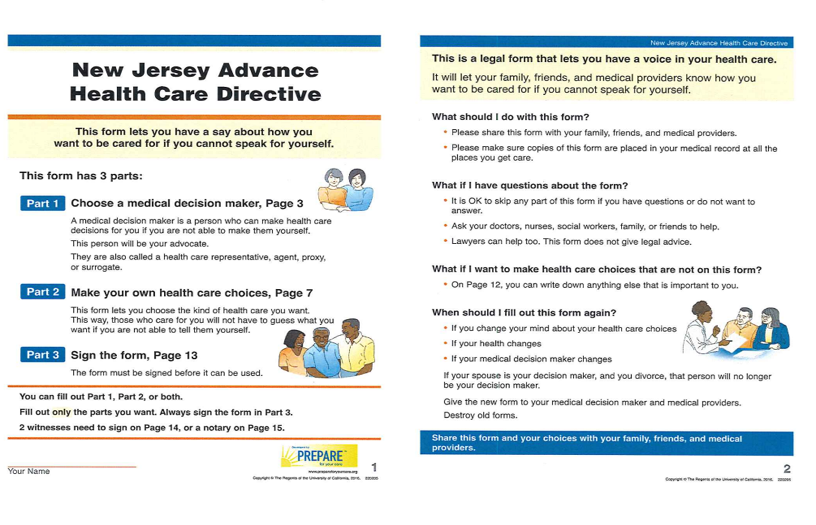

Slide 15
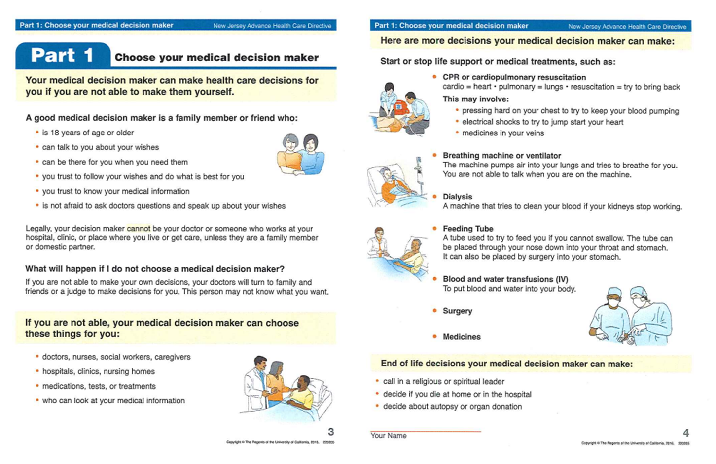

Slide 16
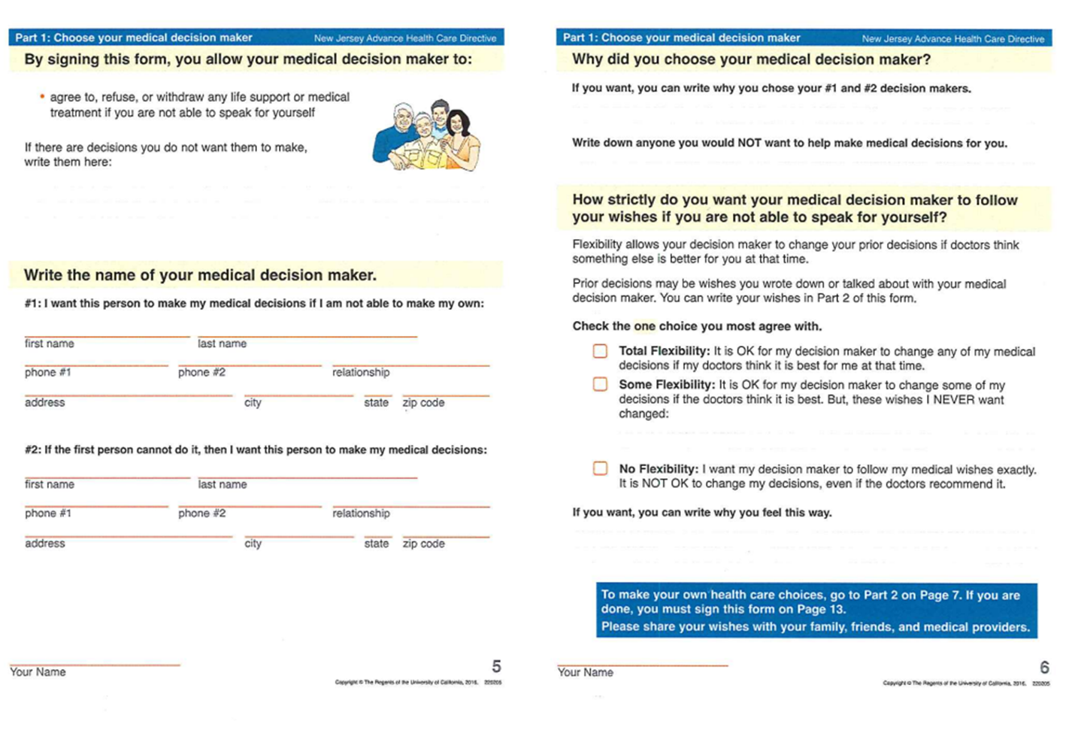

Slide 17
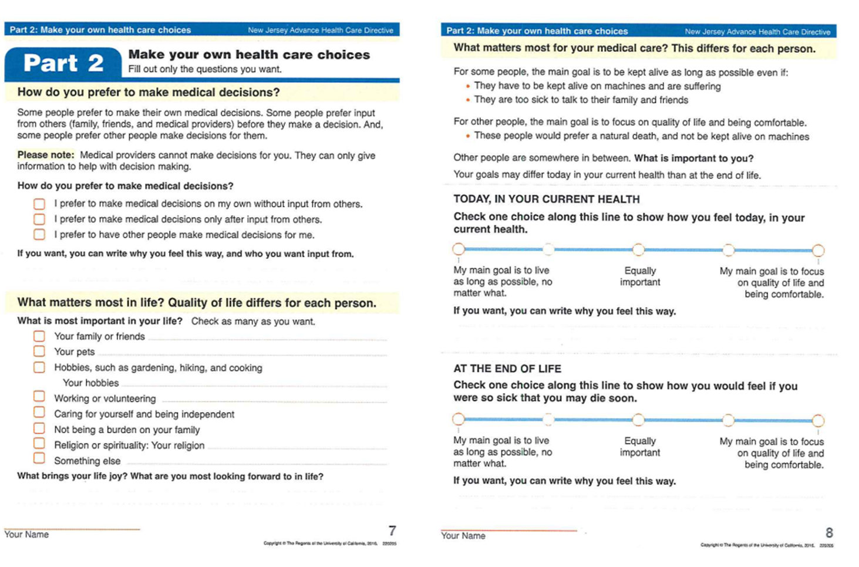

Slide 18
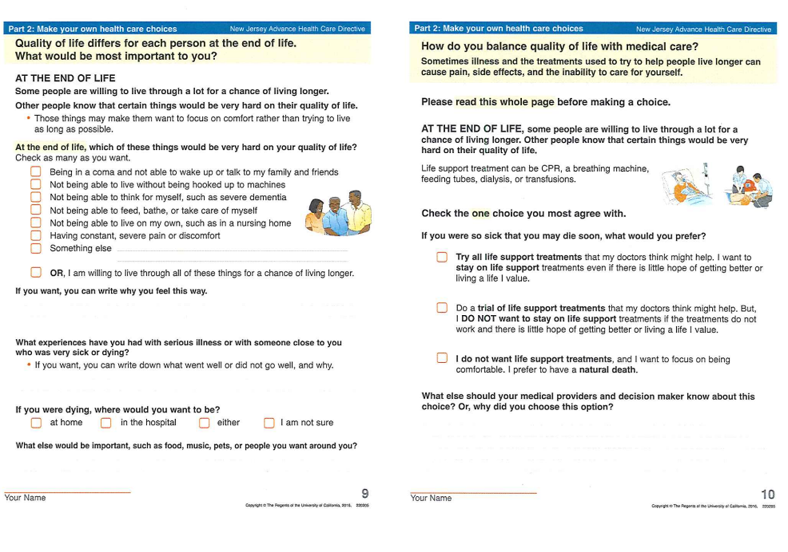

Slide 19
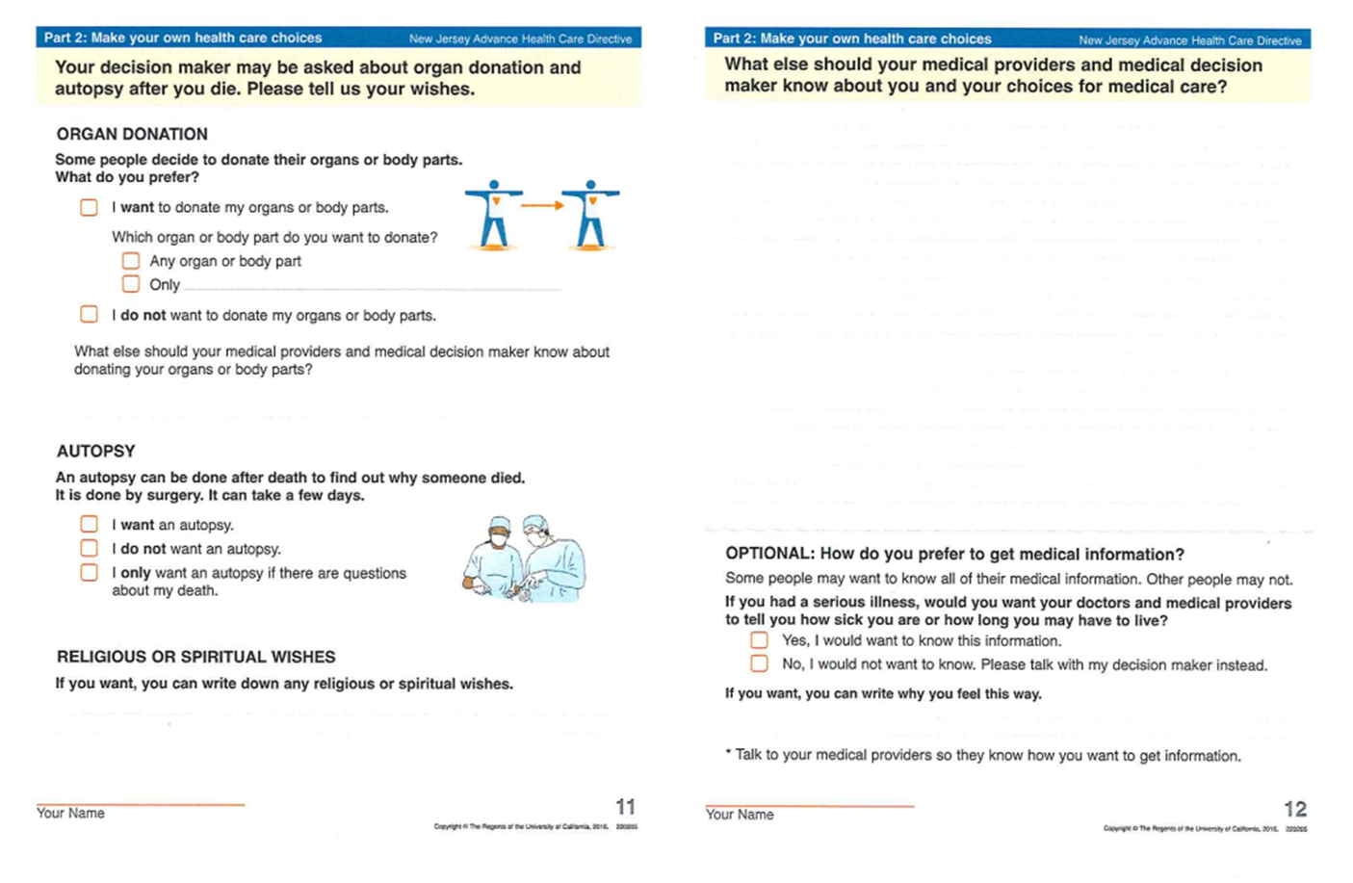

Slide 20
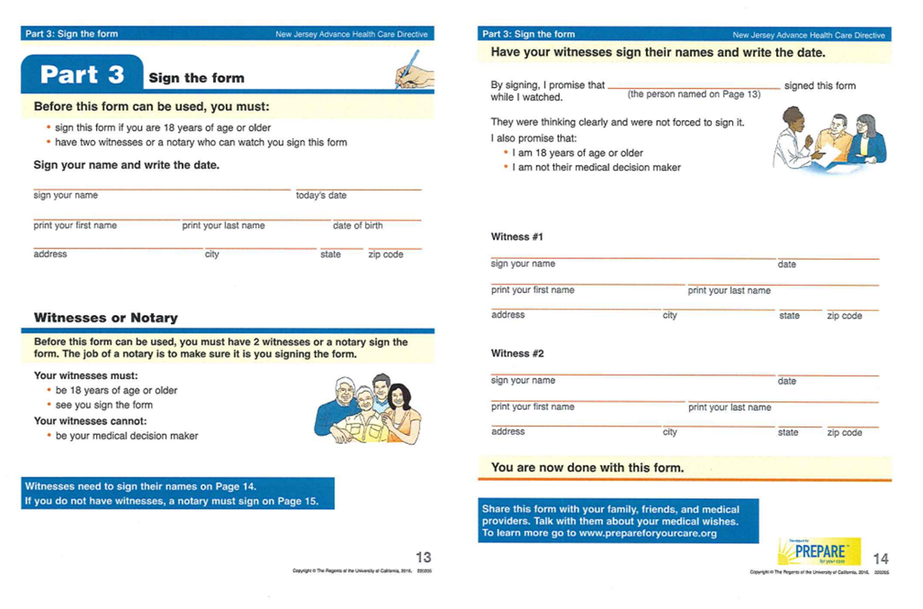

Slide 21
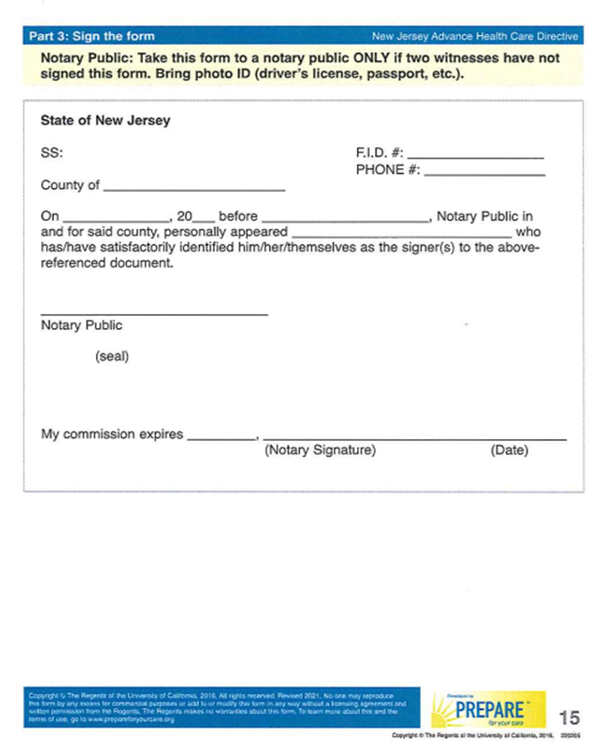
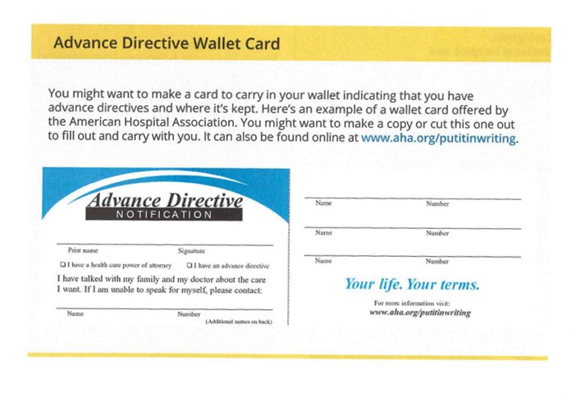
Wallet Card

Slide 22
Resources
https://theconversationproject.org/
https://www.acpdecisions.org/
https://agingwithdignity.org/
https://www.cancer.net/sites/cancer.net/files/advanced_cancer_care_planning.pdf
http://www.begintheconversation.org/
https://prepareforyourcare.org/en/welcome
https://www.nj.gov/health/advancedirective/ad/forums-faqs/
https://www.cancer.org/cancer/managing-cancer/making-treatment-decisions/advance-directives/setting-up-a-good-adv-health-care-directive.html
https://mydirectives.com/
https://codaalliance.org/
https://www.caringinfo.org/
https://www.nia.nih.gov/health/advance-care-planning-advance-directives-health-care

